Slide 1


K-Means Algorithms
Project Overview
Ertuğrul ÇAT - 230709016
İremsu Ümit - 220709027

Slide 2
Why
The aim of this project is to group cities in Türkiye that share similar characteristics based on the number of students coming to our university from different cities.
How
The K-Means results divide cities into 3 clusters:
1. Cluster: Cities with a low number of students but a higher number of students.
2. Cluster: Cities sending a moderate number of students (Ankara, Istanbul, Bursa, Trabzon, etc.).
3. Cluster: Cities with a very high number of students, such as Erzurum.
The results were visualized in two different ways:
3D K-Means Graph: The distances between cities and the distinction between clusters are clearly visible according to the three student groups.
Clustering on the Map of Turkey: Both the clusters and geographical distributions of the cities were examined together. It was observed that cities with similar student profiles were grouped in certain regions on the map.

Slide 3
How
The data used in the project consists of three different student groups. For each city:
  Number of students in Group 1
  Number of students in Group 2
  Number of students in Group 3
  Geographic coordinates (Lat–Lon)
were used.
To ensure the algorithm works correctly, the data was first normalized. Then, the optimal number of clusters was determined using the Elbow method. In this method, different k values ​​were tested, and k = 3, where the sharpest breakpoint was found, was selected.
K-Means Algorithm
  Run with 20 replicates.
  K-Means++ initialization method was used.
  The best result with low error was automatically selected.
This resulted in stable and reliable clusters

Slide 4
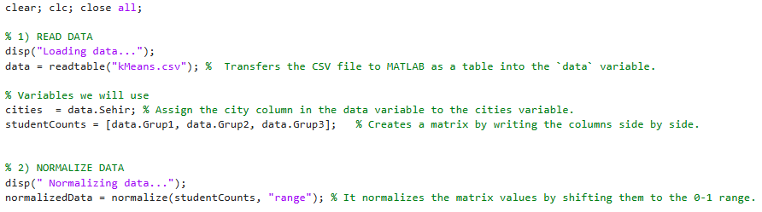
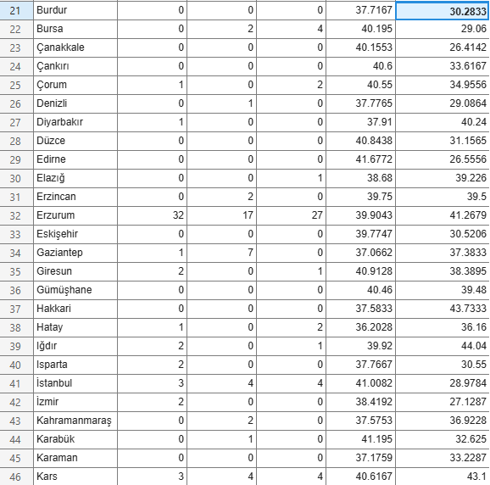

Slide 5
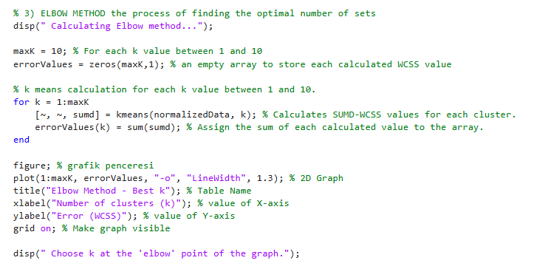
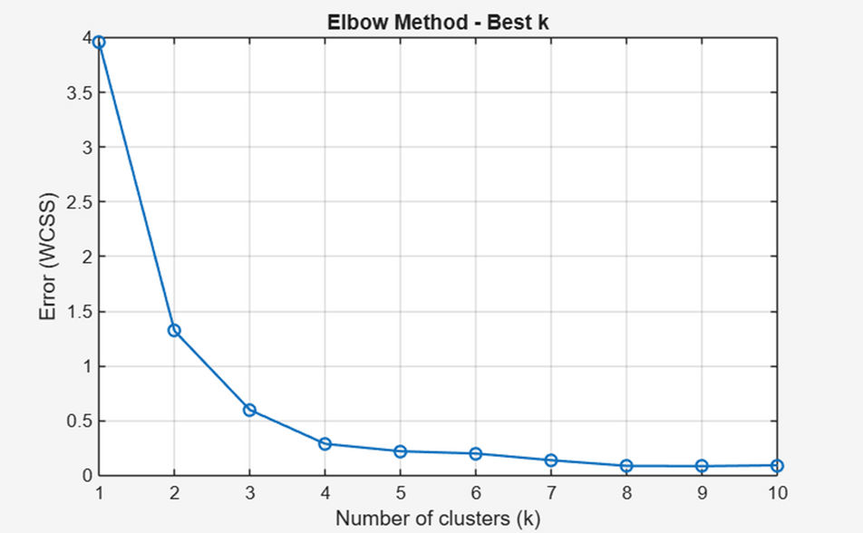

Slide 6
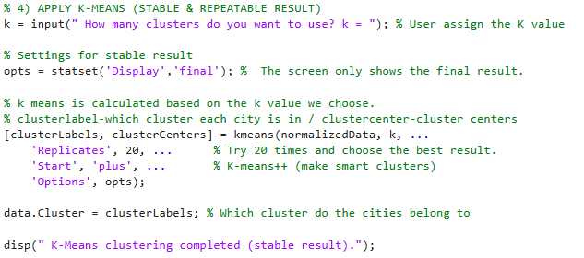
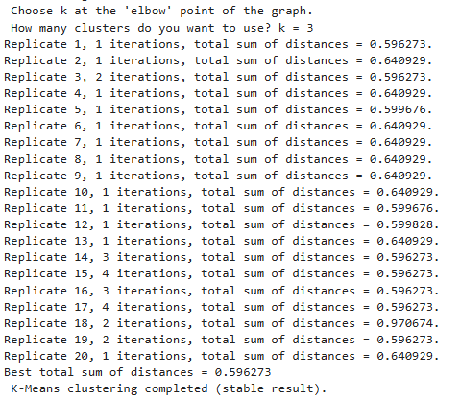
To obtain more stable and accurate results, it was run 20 times (Replicates = 20). Since K-Means randomly selects the starting centers in each run, each replication produces a different error value (WCSS). At the end of each replication, MATLAB records:
  the number of iterations,
  the total error value,
  the quality of the resulting clusters.
After 20 runs, the replication with the lowest total error (0.596273) was selected as the best model, and the clustering of cities was done according to this result.

Slide 7
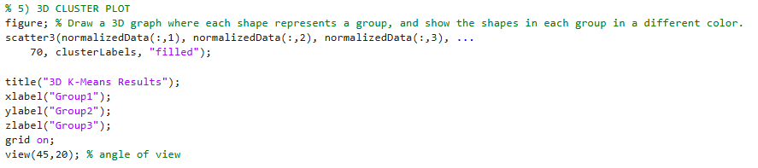
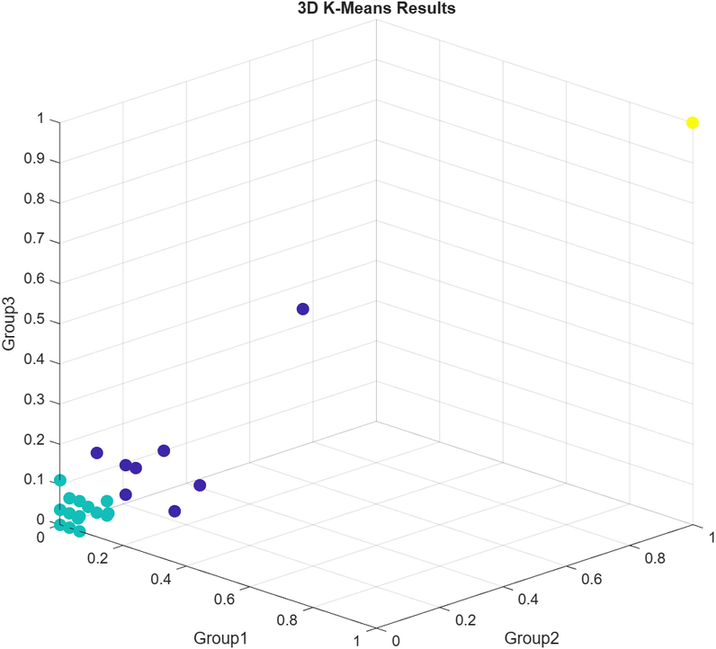
This graph is a K-Means clustering visualization showing cities in 3D according to the number of students in three different groups. Each color represents a different cluster, and cities are seen as being close or far apart based on their data similarities. This allows us to observe the differences between clusters more clearly and easily understand which cities have similar student profiles.

Slide 8
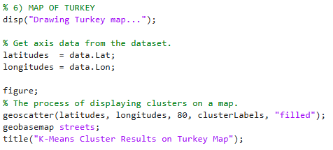
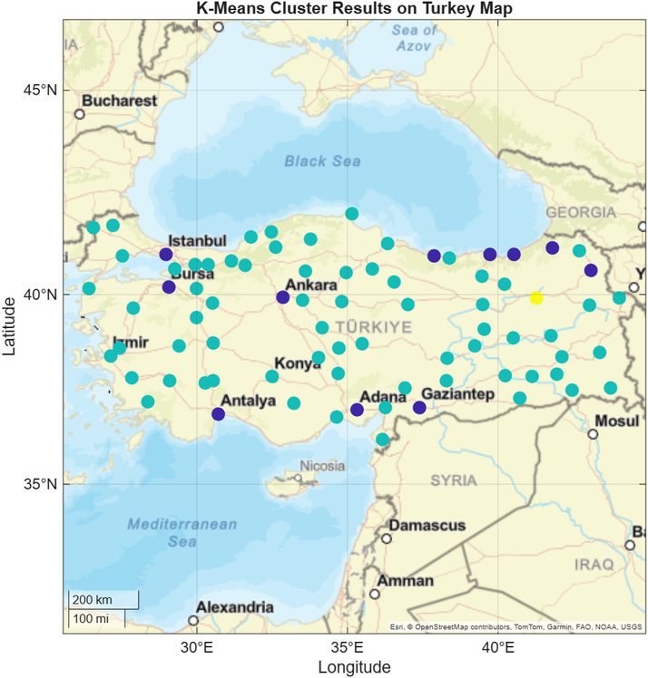
This graph shows the clusters generated by the K-Means algorithm on a map of Türkiye. Each city is colored according to its cluster number. This allows us to visually examine how cities with similar student profiles are geographically distributed.

Slide 9
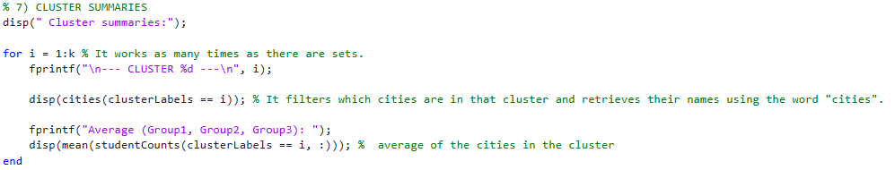
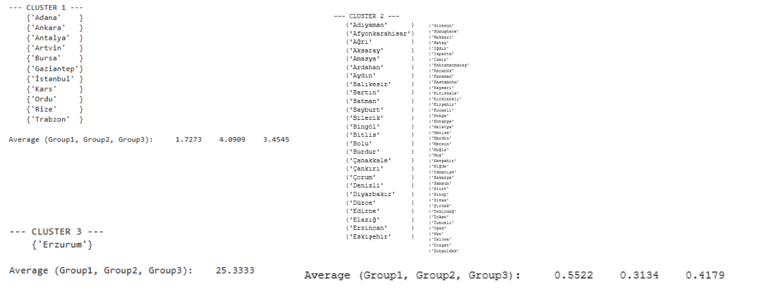

Slide 10
Project Summary
The K-Means algorithm was applied to normalized student data, and the optimal number of clusters was determined to be three using the Elbow method. Stable results were obtained using the Replicates method, reliably analyzing the similarity structures of the cities. Graphical visualizations clearly showed the separation between clusters and their geographical distribution.

Slide 11
Thank you!
For Listening

